Slide 1

SECURE CLIENT SERVER FILE TRANSFER
SUBMITTED BY:
Ashish Pandey (500063104) Mridul Thapa (500060077) Nikhil Mishra (500062584) Surabhi Kumari (500063663)
Under the guidance of
Mr. Pushpendra Kumar Rajput
Assistant Professor
Department of Cybernetics

Slide 2
Problem Statement
In the client-server communication model the client applications running on devices are insecure and exposed to security threats, where normally the server side is sufficiently protected and sealed from public access, but client applications running on devices like notebooks and desktops are considered insecure and exposed to security threats.

Slide 3
OBJECTIVE
To develop a channel to transfer files securely, using key based encryption methods and comparing the different methods on Linux based OS.

Slide 4
Encryption and Decryption
Encryption is a process of translating a plain text into something that appears to be random and meaningless and is difficult to decipher.
Decryption is a process of transforming encrypted information back into original data.
It’s Need
Provides security of data at all times.
Maintains integrity
Ensures privacy
Protects data across devices

Slide 5
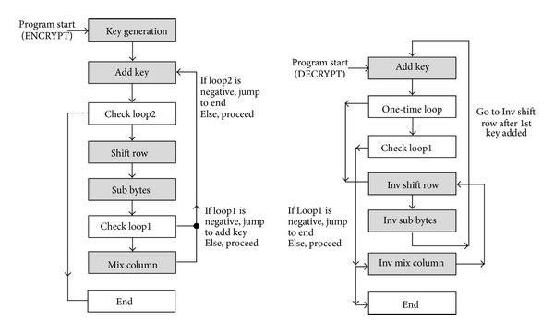
Use case of Encryption/Decryption
End to End encryption
Virtual private networks (VPN)
Secure Web Browsing

Slide 6
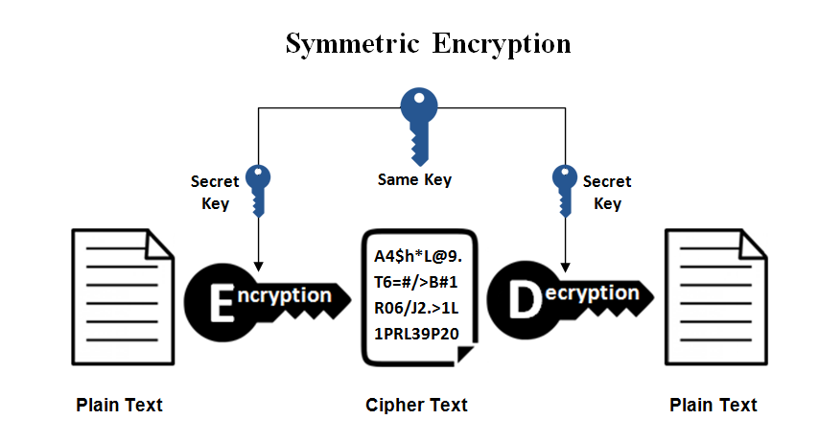
Algorithms used
(AES) Advance Encryption Standard Algorithm:
It involves only one secret key to cipher and decipher information. The secret key that can either be a number, a word or a string of random letters. The sender and the recipient should know the secret key that is used to encrypt and decrypt all the files.
Notes:
The idea of RSA is based on the fact that it is difficult to factorize a large integer. The public key consists of two numbers where one number is multiplication of two large prime numbers. And private key is also derived from the same two prime numbers. RSA keys can be typically 1024 or 2048 bits long, but experts believe that 1024 bit keys could be broken in the near future.

Slide 7
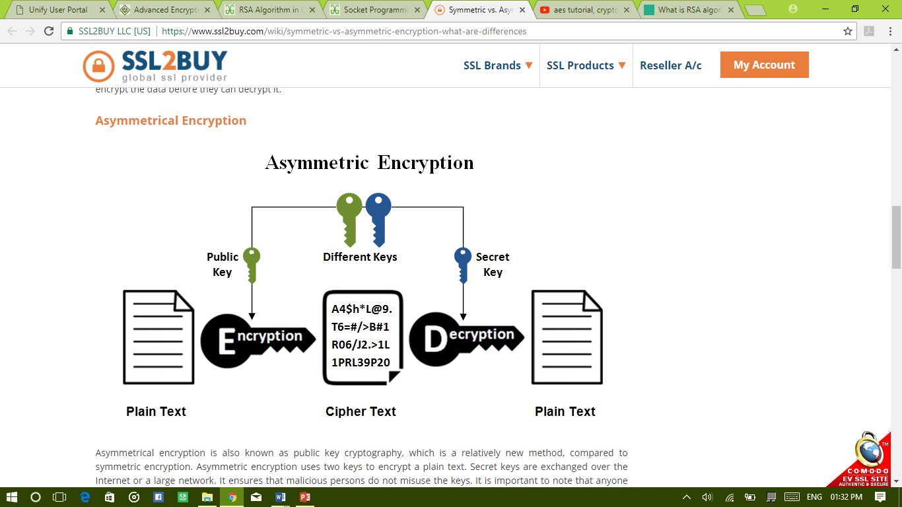
RSA(Rivest–Shamir–Adleman) Algorithm:
RSA is the standard asymmetric algorithm, It uses two keys for encryption. The public key is open and the client uses it to encrypt a random session key. Anyone intercepts the encrypted key must use the second key, the private key, to decrypt it.
Notes:
The idea of RSA is based on the fact that it is difficult to factorize a large integer. The public key consists of two numbers where one number is multiplication of two large prime numbers. And private key is also derived from the same two prime numbers. RSA keys can be typically 1024 or 2048 bits long, but experts believe that 1024 bit keys could be broken in the near future.

Slide 8
Encryption and Decryption of a file between two terminals using AES Algorithm

Slide 9
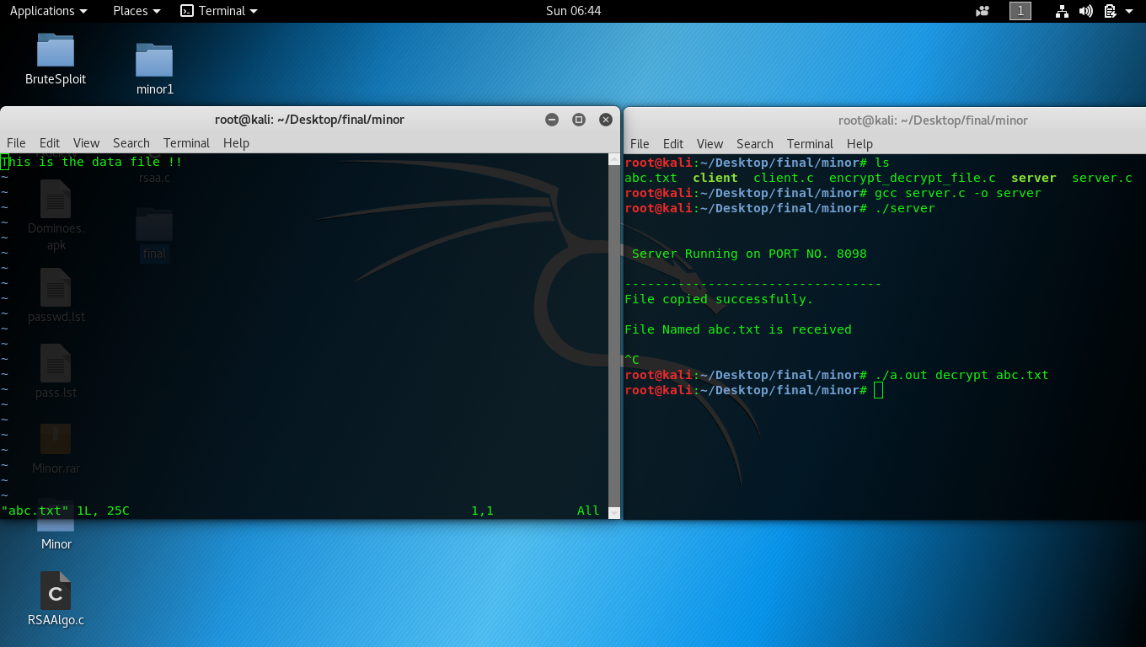
BEFORE ENCRYPTION

Slide 10
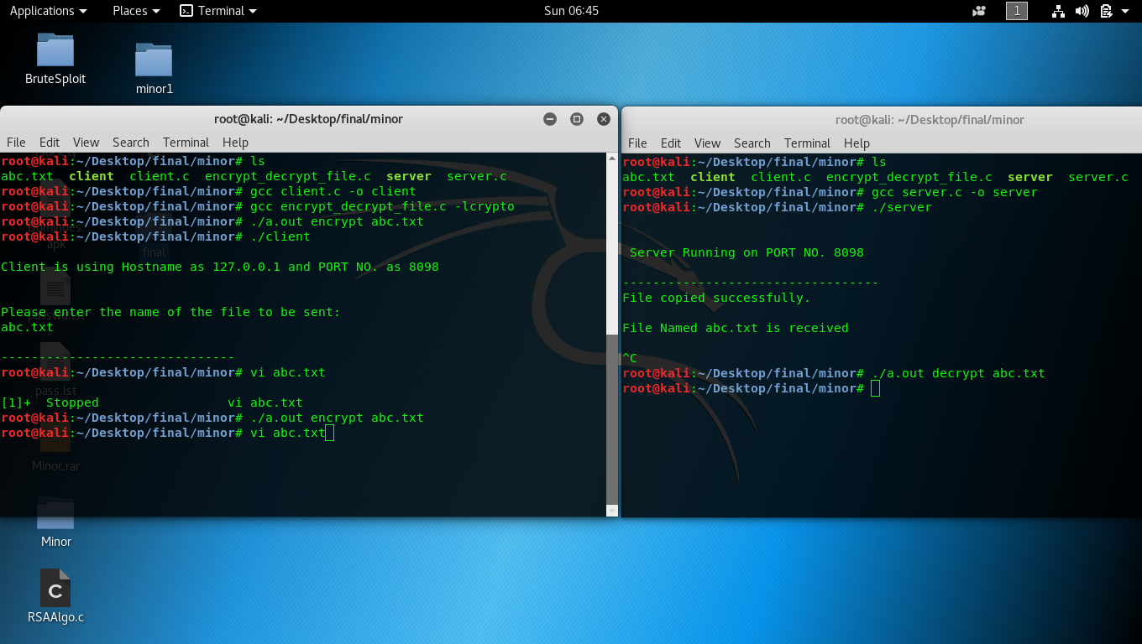

Slide 11
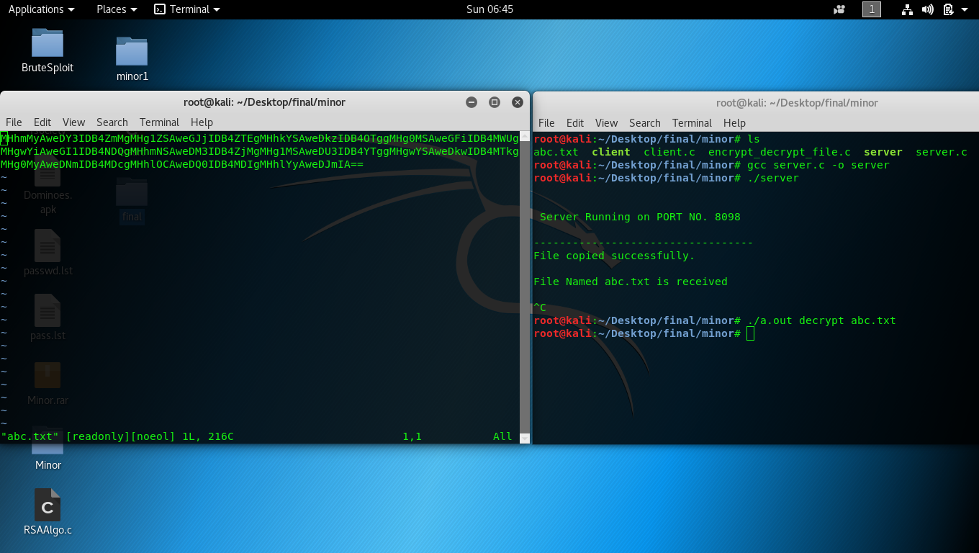
ENCRYPTED FILE

Slide 12
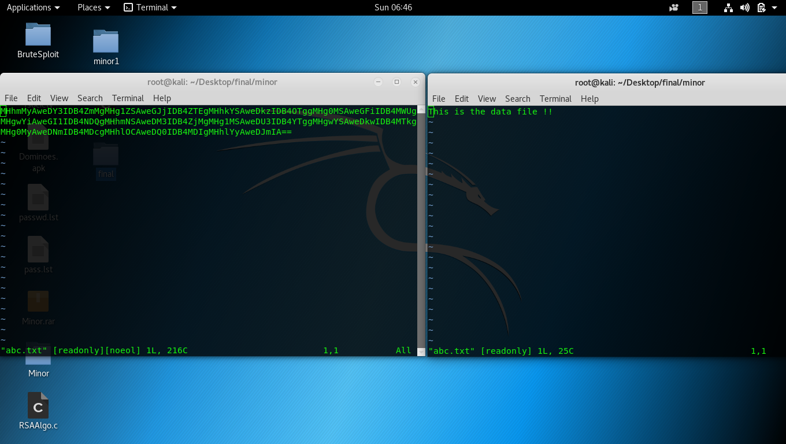
DECRYPTED FILE

Slide 13


